Slide 1

Java 17 New Features
Dima Ionut Daniel

Slide 2
Contents
What is Java?
History
Java Flavors
New Features
Core
Other Improvements
Bibliography

Slide 3

What is Java?
Java is a programming language created by Sun Microsystems.
Java is used in a wide variety of computing platforms from embedded devices and mobile phones on the low end, to enterprise servers and supercomputers on the high end.
Memory management is handled through integrated automatic garbage collection performed by the JVM.
The heart of the Java platform is the concept of a "virtual machine" that executes Java bytecode programs. This bytecode is the same no matter what hardware or operating system the program is running under.
There is a JIT(Just-In-Time) compiler within the Java Virtual Machine, or JVM. The JIT compiler translates the Java bytecode into native processor instructions at run-time and caches the native code in memory during execution.
The Java programs are cross-platform or platform independent, but the code of the Java Virtual Machines (JVM) that execute these programs is not.

Slide 4
History
The initial Java release was named Oak, and the first stable version was JDK 1.0.2, called Java 1.
JDK 1.0 - 23 January 1996
JDK 1.1 – 19 February 1997
J2SE 1.2 – 8 December 1998 (codename Playground)
J2SE 1.3 – 8 May 2000 (codename Kestrel)
J2SE 1.4 – 6 February 2002 (codename Merlin)
J2SE 5.0 – 30 September 2004 (codename Tiger)
Java SE 6 – 11 December 2006 (codename Mustang)
Java SE 7 – 7 July 2011(codename Dolphin)
Java SE 8 – 18 March 2014 (codename Spider)

Slide 5
History (cont.)
Java SE 9 – 21 September 2017
Java SE 10 – 20 March 2018
Java SE 11 – 25 September 2018
Java SE 12 – 19 March 2019
Java SE 13 – 17 September 2019
Java SE 14 – 17 March 2020
Java SE 15 – 16 September 2020
Java SE 16 – 16 March 2021
Java SE 17 – 14 September 2021

Slide 6
Java Flavors
The Java distribution comes in different flavors:
Java Card →run securely on smart cards and similar small-memory devices.
Java ME(Micro Edition) → Specifies several different sets of libraries (known as profiles) for devices with limited storage, display, and power capacities.
Java SE(Standard Edition) → for general-purpose use on desktop PCs, servers and similar devices.
Java EE(Enterprise Edition) → Java SE plus various APIs useful for multi-tier client–server enterprise applications.

Slide 7
New Features
JEP 306 - Restore Always-Strict Floating-Point Semantics
JEP 356 - Enhanced Pseudo-Random Number Generators
JEP 382 - New macOS Rendering Pipeline
JEP 391 - macOS/AArch64 Port
JEP 398 - Deprecate the Applet API for Removal
JEP 403 - Strongly Encapsulate JDK Internals
JEP 406 - Pattern Matching for Switch (Preview)
JEP 407 - Remove RMI Activation
JEP 409 - Sealed Classes
JEP 410 - Remove the Experimental AOT and JIT Compiler
JEP 411 - Deprecate the Security Manager for Removal
JEP 412 - Foreign Function and Memory API (Incubator)
JEP 414 - Vector API (Second Incubator)
JEP 415 - Context-Specific Deserialization Filters

Slide 8
Core
Sealed classes allow you to restrict which classes or interfaces can extend or implement them. This feature enhances encapsulation and helps maintain code integrity by controlling who can inherit from a sealed class.
Sealed classes are part of Project Amber, and this JEP officially introduces a new feature to the language, although it was available in preview mode in the JDK versions 15 and 16.

Slide 9
Core
Benefits of sealed classes:
Compiler Enforcement: The Java compiler enforces the rules of sealed classes. If a class is declared to extend a sealed class but is not listed in its permitted subclasses, the compiler will reject it.
Reflection API: Java’s reflection API has been updated to recognize sealed classes and their permitted subclasses.
Pattern Matching: Sealed classes enhance pattern matching by ensuring that all possible subtypes are covered in a switch expression, thus avoiding the need for a default case.

Slide 10
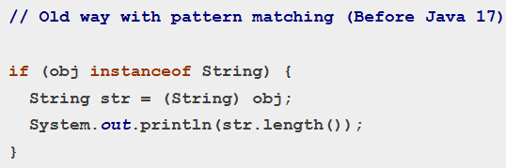
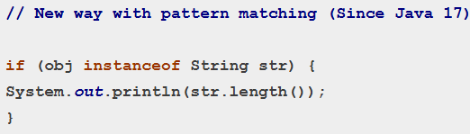
Core
Pattern Matching for instanceof (JEP 411) simplifies the common codding pattern of using `instanceof` followed by a cast.

Slide 11
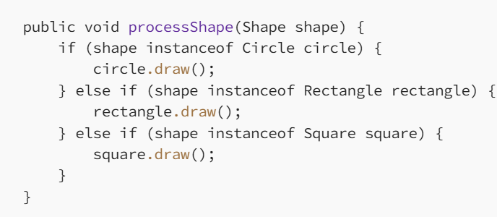
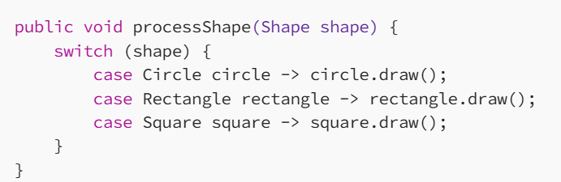
Core
Pattern Matching for Switch (JEP 406).

Slide 12


Core
“Enhanced Pseudo-Random Number Generators” provides additional pseudo-random number generators (PRNGs) that can be used to generate random numbers in Java applications.
The new PRNGs are designed to be faster and more secure than the existing PRNGs in Java.
Another useful feature of the SplittableRandom class is that it allows us to split the PRNG and create new instances that generate independent sequences of random numbers.

Slide 13
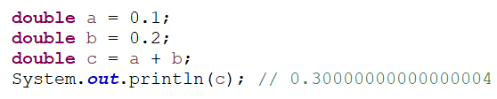
Core
“Restore Always-Strict Floating-Point Semantics” aims to improve the consistency and reliability of floating-point arithmetic in Java applications. It can be mainly important in applications where precision is critical.
Prior to Java 17, some floating-point operations in Java were not always strictly adhering to the IEEE 754 floating-point standard, which can lead to inconsistent behavior across different platforms and architectures

Slide 14
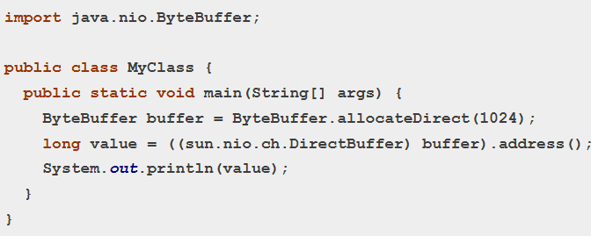
Core (cont.)
The “Strongly Encapsulate JDK Internals” feature aims to further enhance the encapsulation of internal APIs in the JDK (Java Development Kit).The goal is to limit the use of internal APIs by third-party applications and libraries, which can improve the security and stability of Java applications.
Internal APIs are not intended for use by third-party applications, as they may change or be removed without notice in future JDK releases.
With the “Strongly Encapsulate JDK Internals” feature, access to internal APIs is more restricted. Any code that tries to access internal APIs will result in a warning message or a compilation error, depending on the specific API.

Slide 15
Core (cont.)
The “macOS Rendering Pipeline” feature improves the performance and reliability of Java graphics on macOS by introducing a new rendering pipeline. This pipeline uses the Apple Metal API, which provides low-level access to the graphics hardware on macOS, resulting in faster and smoother graphics rendering.
Prior to Java 17, Java applications on macOS used the OpenGL pipeline, which can be slower and less reliable than the new Metal pipeline. The Metal pipeline provides better performance and reliability by allowing Java applications to directly access the graphics hardware on macOS, resulting in smoother and more responsive graphics rendering.

Slide 16
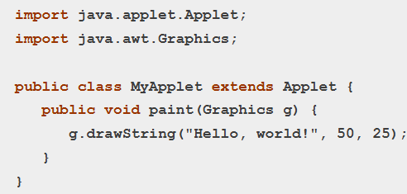
Core (cont.)
The “Deprecate the Applet API for Removal” feature involves marking the Applet API as deprecated, which means that it is no more recommended for use and may be removed in a future version of Java. The Applet API is used to create Java applets, which are small applications that run within a web browser.
With the deprecation of the Applet API, it is recommended to use alternative technologies such as Java Web Start, JavaFX, or HTML5 for developing web-based applications.

Slide 17
Core (cont.)
“Foreign Function & Memory API” (Incubator) - JEP 412 was first introduced in Java 14 as an incubator module under JEP 370.
It is part of Java’s effort to evolve the Java foreign function and memory API.
The main goal of this API is to provide a pure Java API for calling native code and working with native memory, as a more efficient way of working with native functions as opposed to JNI.
Key goals of JEP 412 include:
Interoperability with Native Code: It provides a way to call native functions and handle native data structures without the need for the traditional Java Native Interface (JNI), which can be complex and error-prone.
Memory Management: It introduces an API for managing memory outside of the Java heap. This allows developers to allocate, access, and free native memory in a safe and efficient manner.
Safety and Performance: The API is designed to be safer by minimizing common programming errors, such as buffer overflows, while also being more performant than existing solutions.

Slide 18
Core (cont.)
The "macOS/AArch64 Port" feature, (JEP 391) is designed to enhance the Java programming language and its ecosystem.
It was introduced to support the macOS operating system on AArch64 architecture, which includes Apple's M1 and M2 chips.
The main goals of JEP 391 include:
Platform Support: It aims to provide native support for Java on macOS systems that use the AArch64 architecture, allowing developers to run Java applications efficiently on the latest Apple hardware.
Performance Optimization: The project focuses on optimizing the Java Virtual Machine (JVM) for the AArch64 platform to ensure that Java applications perform well by leveraging the capabilities of the new hardware.
Integration: This enhancement provides a more integrated experience for developers working on macOS using AArch64, ensuring that they have access to the same features and performance advantages as on other platforms.

Slide 19
Core (cont.)
The "Deprecate the Security Manager for Removal" JEP 411 feature has been deprecated for removal in future versions and its associated API in the Java programming language.
This proposal was motivated by the fact that the Security Manager has become less relevant in modern application development due to changes in software design and deployment practices, such as the rise of microservices and cloud-native applications.

Slide 20
Core (cont.)
The "Context-Specific Deserialization Filters" (JEP 384) feature was introduced to improve the security of Java applications by providing a better way to filter deserialization cases.
This feature allows Java developers to manage scoped values in a way that simplifies handling contextual information throughout an application.
Scoped values are objects that are intended to be passed around in a specific scope, providing a mechanism to share data without using global state or complex dependency injection mechanisms.

Slide 21
Other Improvements
Marked for removal in version 15, the RMI activation API (JEP 407) was removed from the platform in version 17.
The java.lang package has been enhanced with methods like the String class's strip, isBlank, and lines, which provide more convenient options for string manipulation.
Javadoc improvements include better search functionality, improved API documentation, and new features for generating documentation.
There are numerous performance improvements, garbage collection enhancements, and bug fixes that enhance the overall stability and efficiency of the JVM.

Slide 22

Bibliography
http://en.wikipedia.org/wiki/Java_(programming_language)
https://www.baeldung.com/java-17-new-features
https://www.oracle.com/java/technologies/javase/17-relnote-issues.html
https://www.javatpoint.com/java-17-new-features
https://dzone.com/articles/effectively-sealed-classes-in-java
https://adevait.com/java/jdk-17-new-features-java-17

